Slide 1
Natural language processing concepts and components

Slide 2
Unit objectives
Define the NLP categories.
Describe the NLP pipeline.
Explain the challenges in natural language understanding (NLU).
Explain the concepts of information retrieval and extraction.
Describe sentiment analysis.

Slide 3
Topics
Natural language processing categories
Language ambiguities
Natural language processing phases and pipeline
Information retrieval
Information extraction

Slide 4
Natural language processing categories

Slide 5
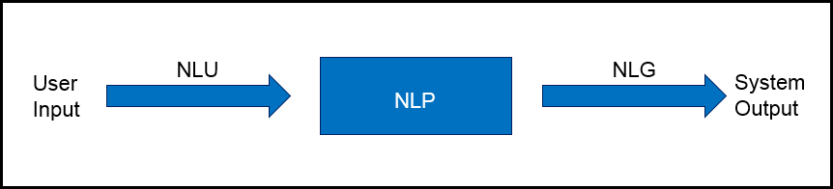
Natural language processing categories
Natural language understanding (NLU)
Natural language generation (NLG)
Notes:
There are two categories of NLP:
Natural language understanding (NLU): It is the NLP task of extracting insights from natural language inputs.
Natural language generation (NLG): it is the NLP task of building natural language outputs from non-linguistic inputs.
Natural language exists in various media, such as text in documents, reports, or messages, or speech.
The graphic in the slide shows that NLU is the NLP process that takes input text while NLG is the NLP process that generates text as output.

Slide 6
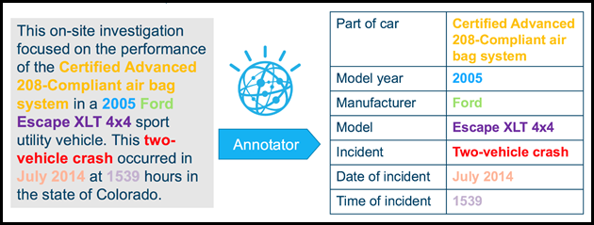
NLU applications
Unstructured to structured
Question and answer system
Sentiment analysis
Notes:
NLU analyzes language to gain insights into the text. There are many examples of NLU applications:
Mapping a user’s unstructured input to a computer representation (structured data) and relation extraction
Question and answering system
Sentiment analysis
The graphic in the slide shows an example of converting unstructured to structured data. The input to the NLU system is natural language (unstructured text) and through the NLP process it is converted to structured data (table).
References:
Natural Language Generation: An Overview
http://www.lacsc.org/papers/PaperA6.pdf
Understanding Natural Language Understanding
https://nlp.stanford.edu/~wcmac/papers/20140716-UNLU.pdf

Slide 7
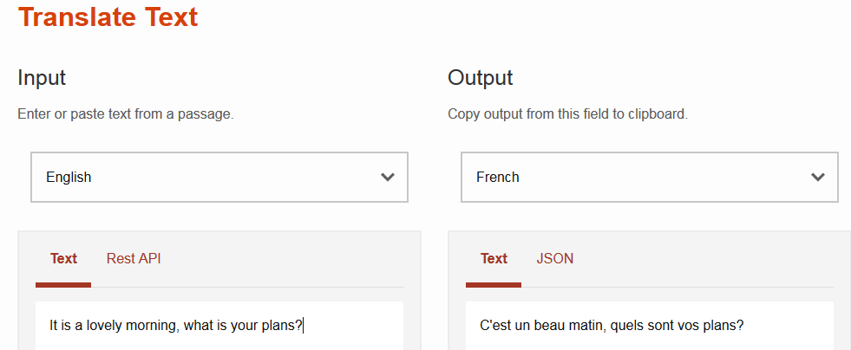
NLG applications
Machine translation
Text summarization
Weather forecasting system
Notes:
Here are some NLG application examples:
Translator.
Text summarization.
Weather Forecasting Systems, which compile graphical weather maps representations and interpret the numbers that come from the prediction system. By using NLG, you can transform this information into natural language.
References:
Watson Language Translator
https://www.ibm.com/cloud/watson-language-translator
Natural Language GenerationScope, Applications and Approaches
http://www.academia.edu/3879518/Natural_Language_Generation_Scope_Applications_and_Approaches

Slide 8
Language ambiguities

Slide 9
Language ambiguities
Lexical ambiguity: A primitive level, such as at the word level
Verb versus noun:
“We will dance all night.”
“This is the salsa dance.”
“John will go to work.”
“His uncle left him millions in his will.”
Notes:
Building applications with NLP processes is not a trivial task. Natural language includes many ambiguities, such as a lexical ambiguity, which is a primitive level, such as at the word level.
Two examples:
The word dance can be a verb (“We will dance all night.”) or a noun (“This is the salsa dance.”).
The word will can be a helping verb to indicate an action in the future (“John will go to work”) or a noun (“His uncle left him millions in his will.”).

Slide 10
Language ambiguities (cont.)
Syntactic-level ambiguity: A sentence that can be parsed in various ways.
Example: “She pointed at the guy with the umbrella.”
Anaphora ambiguity occurs when it is not clear which one is the antecedent noun that a pronoun replaces because more than one possible antecedent exists.
Example: “When Mary invited Ann to play, she did not know that she would be late”.
Notes:
Here are two more types of language ambiguity:
Syntactic-level ambiguity: A sentence that can be parsed in various ways. For example: “She pointed at the guy with the umbrella.” Did she use her umbrella to point at the guy or did she point at the guy who is carrying an umbrella?
Anaphora is an expression for which the interpretation depends on another expression that was previously introduced. The referring term is called anaphor and it is usually a pronoun. The pronoun takes the place of a noun but, to avoid ambiguity, the pronoun must refer clearly to the noun that the pronoun replaces.
An anaphora ambiguity occurs when more than one possible antecedent exists. For example: “When Mary invited Ann to play she did not know that she would be late.” Is the first “she” replacing Mary or Ann? Who did not know? Is the second “she” replacing Mary or Ann? Who would be late?
References:
Syntactic ambiguity
https://en.wikipedia.org/wiki/Syntactic_ambiguity
Anaphora (linguistics)
https://en.wikipedia.org/wiki/Anaphora_(linguistics)

Slide 11
Natural language processing phases and pipeline

Slide 12
Natural language processing phases
Morphological Analysis/ Lexical Analysis
Breaks down the text paragraphs, sentences, and words.
Syntactic Analysis
Semantic Analysis
Extracts meaningful information from the text.
Analysis is done for identification and description of the structure of words.
Rejects and ignores the sentences that do not make sense.
Discourse Integration
Helps in studying the whole text.
Pragmatic Analysis
Interprets the text by using information from the previous steps.
Understands the communicative and social content.
Studies the underlying meaning of a spoken or written text as it considers the social and historical contexts.
Checks grammar, arrangements of words, and the relationship between the words.
Techniques used: stop word removal, tokenization, stemming, and lemmatization.
Techniques used: dependency parsing, and part of speech (POS) tagging.
Notes:
The NLP five phases or stages are:
Morphological Analysis
Morphological analysis is a field of linguistics that studies the structure of words. It identifies how a word is produced by using morphemes. The morpheme is the smallest element of a word that has grammatical function and meaning. It is a meaningful morphological unit of a language that cannot be further divided.
Also, this phase is called lexical analysis, which deals with the study at the level of words regarding their lexical meaning and part-of-speech. This level of linguistic processing uses a language's lexicon. Lexicon of a language is the collection of words and phrases in that language. The lexical analysis divides the text into paragraphs, sentences, and words. Lexical normalization, which is the process of converting or transforming a nonstandard text to a standard register, is performed. Lexical normalization includes techniques such as:
Stop word removal (removing for example ‘and’, ‘of’, ‘the’ from text)
Tokenization (breaking the text into sentences or words)
Word tokenizer
Sentence tokenizer
Tweet tokenizer
Stemming (removing ‘ing’, ‘es’, ‘s’ from the tail of the words)
Lemmatization (converting the words to their base forms)
Syntactic Analysis
Syntactic analysis is the analysis that provides the logical meaning of a sentence or parts of that sentence. It is the process of analyzing natural language with the rules of formal grammar. Grammatical rules are applied to categories and groups of words, not to individual words.
Syntactic Analysis is used to check grammar, arrangements of words, and the interrelationship between the words.
Example: “Mumbai goes to the Sara”. This sentence does not make sense, so this sentence is rejected by a syntactic analyzer.
Syntactical parsing involves the analysis of words in the sentence for grammar. Dependency grammar and part of speech (POS) tags are the important attributes of text syntactic.
Some of the techniques that are used in this phase are:
Dependency Parsing
Part of Speech (POS) tagging
Semantic Analysis
Semantic analysis retrieves the possible meanings of a sentence that is clear and semantically correct. It is the process of retrieving meaningful insights from text.
Discourse Integration
Discourse integration refers to the context of a sentence or word. The meaning of a sentence depends on the meaning of the sentence just before it. In addition, it also brings about the meaning of the immediately succeeding sentence.
For example, the word “that” in the sentence “He wanted that” depends upon the prior discourse context.
Pragmatic Analysis
Pragmatic analysis is the study of meanings in a language. In involves the process of extraction of insights from the text. Through Pragmatic Analysis, what was described is reinterpreted by what it was meant. It derives the various aspects of language that require real-world knowledge. It means to abstract the meaningful use of language in situations. In this analysis, the focus is always on what was said is reinterpreted on what is intended.
For example, the sentence “Please crack the door open” does not mean to break the door but to open it a small amount.
References:
Phases in Natural Language Processing
https://padhaitime.com/Natural-Language-Processing/Phases-in-NLP
Stages of Natural Language Processing
https://byteiota.com/stages-of-nlp/
The 5 Phases of Natural Language Processing
https://www.optisolbusiness.com/insight/the-5-phases-of-natural-language-processing
Natural Language Processing Step by Step Guide
https://www.analyticsvidhya.com/blog/2021/05/natural-language-processing-step-by-step-guide/#h2_6

Slide 13
Natural language processing pipeline
A pipeline is a way to design a program in which the output of one module feeds into the input of the next module.
Using the NLP pipeline divides the tasks of NLU, which makes NLU less complex.
For example, use NLP pipeline to understand the following sentence:
“Yes, I got the invitation, and I will happily attend your party in London.”
Notes:
When you work on an NLP task like machine translation, you must perform a set of processes and activities. This set of processes is the NLP pipeline.
A pipeline is a process for designing a program in which the output of one module feeds into the input of the next module. You use the pipeline to break down the complexity of the NLP task into a smaller set of less complicated tasks. There are no strict rules for the activities that must be done in the pipeline.
The following slides, explore some of these activities by using the following example:
“Yes, I received your invitation, and I will happily attend your party in London.”
This statement is understandable by a human but not a computer. We use the pipeline to walk through each stage to analyze the statement.
Reference:
CoreNLP Pipelines
https://stanfordnlp.github.io/CoreNLP/pipelines.html

Slide 14
Natural language processing pipeline
Sentence segmentation
Word tokenization
Stemming
Chunking
Lemmatization
Stop words removal
Dependency Parsing (DP)
Part of speech (POS) tagging
Named entity recognition (NER)
Notes:
NLP uses pipelines to read, decipher, and understand human languages. The slide shows the prime processes of the NLP pipelines.
References:
Preprocessing steps in Natural Language Processing (NLP)
https://www.educative.io/answers/preprocessing-steps-in-natural-language-processing-nlp
How to build an NLP pipeline
https://www.wikitechy.com/tutorial/nlp/how-to-build-an-nlp-pipeline

Slide 15
Natural language processing pipeline (cont.)
Sentence segmentation:
Detect sentence boundaries.
There are two sentences in the example that are separated by the conjunction “and”:
“Yes, I got the invitation, and I will happily attend your party in London.”
Apply this process to the example:
“Yes, I got the invitation.”
“I will happily attend your party in London.”
Notes:
Sentence segmentation focuses on finding the boundaries of sentences in text, that is, where the sentence starts and ends. This is not an easy task to accomplish due to the possible ambiguity that is caused by punctuation marks.
For example, a period might indicate the end of a sentence, but it might also indicate an abbreviation, a decimal point, or an email address.
Assume that the two sentences here are separated by the conjunction “and”, so the result of this stage is the following sentences:
“Yes, I received your invitation.”
“I will happily attend your party in London.”
Reference:
Sentence boundary disambiguation
https://en.wikipedia.org/wiki/Sentence_boundary_disambiguation

Slide 16
Natural language processing pipeline (cont.)
Word Tokenization:
Breaks a sentence into tokens.
Tokenization uses delimiters, for example, a space ” “.
Apply tokenization to the example:
First sentence: “Yes””,” “I” “got” “the” “invitation”
Second sentence: “I” “will” “happily” “attend” “your” “party” “in” “London”
Notes:
Tokenization is a basic process that breaks a sentence into a group of words, punctuation, numbers, and alphanumerics that are called tokens. The tokenization can be done on multiple delimiters. Assume in the example that you use the white space as delimiter and apply tokenization to the example: First sentence: “Yes””,” “I” “received” “your” “invitation” Second sentence: “I” “will” “happily” “attend” “your” “party” “in” “London”
White space is a standard delimiter but is not sufficiently useful by itself. For example, segmenting “New York” into “New” and “York” might introduce ambiguity because they both refer to a state, so you should preserve the space in-between.
┌ Note ─────────────────
Sentence segmentation, tokenization, and other activities in the pipeline might also differ depending on the language. For example, you cannot use the same English tokenizer with the Japanese language.
└────────────────────

Slide 17
Natural language processing pipeline (cont.)
Stemming:
Removes the prefixes and suffixes to obtain the root word.
The stem does not have to match the morphological root of the word. For example, “Studies” stemmed to “Studi”.
The most popular English stemming algorithm is the Porter's algorithm (Porter, 1980).
Example:
List of words: Affection, Affects, Affecting, Affected, Affecting
Root word: Affect+
Apply stemming to the example:
First sentence: “Yes””,” “I” “got” “the” “invitation”
“invitation” => “invit”
Second sentence: “I” “will” “happily” “attend” “your” “party” “in” “London”
“happily” => “happi”
Notes:
In the stemming step, the prefixes and suffixes are removed to obtain the root word.
Stemming chops words without knowing the context of the word in sentences. It might create the nonexistence meaning of a word. For Example: “Studies” => “Studi”, "troubled" => "troubl".
Stemming is preferred when the meaning of the word is not important for analysis, for example spam detection. Lemmatization is recommended when the meaning of the word is important for analysis, for example, Question & Answer system.
References:
Preprocessing steps in Natural Language Processing (NLP)
https://www.educative.io/answers/preprocessing-steps-in-natural-language-processing-nlp
What is Stemming and Lemmatization in NLP?
https://www.analyticssteps.com/blogs/what-stemming-and-lemmatization-nlp

Slide 18
Porter stemmer
Step Number | Rule | Example
1 | sses → ss ies → I ss → ss s → ø | glasses → glass parties → parti loss → loss hats → hat
2 | ing → ø ed → ø | talking → talk discovered → discover
3 | ational → ate izer → ize ator → ate | operational → operate recognizer → recognize collaborator → collaborate
4 | al → ø able → ø ate → ø | electrical → electric doable → do investigate → investing
Notes:
This table demonstrates some of the rules of the Porter stemmer.

Slide 19
Natural language processing pipeline (cont.)
Lemmatization:
Groups together different inflected forms of a word into a base word called lemma.
Example:
List of words: going, gone, went
Lemma: go
Apply lemmatization to the example:
First sentence: “Yes””,” “I” “got” “the” “invitation”
“got” => “get”
Notes:
An inflected form of a word has a changed spelling or ending that shows the way it is used in sentences: "Finds" and "found" are inflected forms of "find."
Lemmatization groups different inflected forms of a word into a base word called lemma. For example,
List of words: going, gone, went
Lemma: go
References
Preprocessing steps in Natural Language Processing (NLP)
https://www.educative.io/answers/preprocessing-steps-in-natural-language-processing-nlp
What is Stemming and Lemmatization in NLP?
https://www.analyticssteps.com/blogs/what-stemming-and-lemmatization-nlp

Slide 20
Natural language processing pipeline (cont.)
Stop words removal:
Removes a set of commonly used words that do not add much meaning to the sentence.
Allows applications to focus on the important words instead.
Example:
Removing ‘and’, ‘of’, ‘the’ from text
Apply stop word removal to the example:
First sentence: “Yes””,” “I” “got” “the” “invitation”
Removing the word “the”
Notes:
Stop words are the words in any language that do not add much meaning to a sentence. Stop words can safely be ignored without sacrificing the meaning of the sentence. For example, in English, “the”, “is” and “and”, are examples of stop words. In NLP and text mining applications, stop words removal eliminates unimportant words so that applications can focus on the important words instead.
A list of English stop words can be found at https://www.ranks.nl/stopwords
References:
Preprocessing steps in Natural Language Processing (NLP)
https://www.educative.io/answers/preprocessing-steps-in-natural-language-processing-nlp
Stopwords Lists
https://www.ranks.nl/stopwords

Slide 21
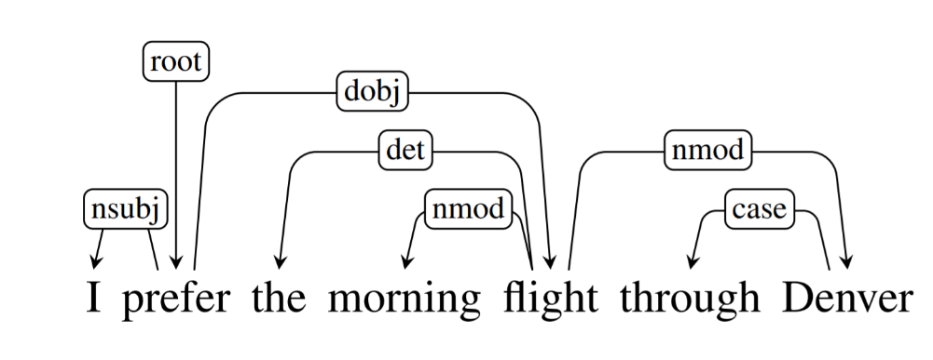
Natural language processing pipeline (cont.)
Dependency Parsing (DP):
Examines the dependencies between the phrases of a sentence to determine its grammatical structure.
Based on the assumption that there is a direct relationship between each linguistic unit in a sentence.
The relationships between each linguistic unit, or phrase, in the sentence are expressed by directed arcs.
Example: The diagram explains the sentence’s dependence structure.
Dependency tag | Description
root | The root of the tree
nsubj | nominal topic
dobj | direct object
det | determiner
nmod | nominal modifier
case | case-marking
Notes:
Dependency Parsing (DP) is the process of examining the dependencies between the phrases of a sentence to determine its grammatical structure. A sentence is divided into sections. The process assumes that there is a direct relationship between each linguistic unit in a sentence. These hyperlinks are called dependencies.
The example in the slide shows a diagram that explains the sentence’s dependence structure.
In a written dependency structure, the relationships between each linguistic unit, or phrase, in the sentence are expressed by directed arcs. In the example, the root of the tree “prefer” varies the pinnacle of the preceding sentence, as labelled in the diagram. Relations among the words are illustrated above the sentence with directed, labeled arcs from heads to dependents. A root node explicitly marks the root of the tree, the head of the entire structure.
A dependence tag indicates the relationship between linguistic units. For example, the word “flight” changes the meaning of the noun “Denver.” As a result, you might identify a dependence flight -> Denver, where flight is the pinnacle or head and Denver is the kid or dependent. It is represented by nmod, which stands for the nominal modifier.
The dependency tags that are used in the example are:
nominal subject (nsubj): nominal, which is the syntactic subject and the proto-agent of a clause.
direct object of a verb (dobj): noun phrase, which is the (accusative) object of the verb.
relation determiner (det): holds between a nominal head and its determiner.
nominal modifier (nmod): The nmod relation is used for nominal dependents of another noun or noun phrase and functionally corresponds to an attribute, or genitive complement.
Case: The case relation is used for any case-marking element, which is treated as a separate syntactic word (including prepositions, postpositions, and clitic case markers). Case-marking elements are treated as dependents of the noun that they attach to or introduce.
References:
Dependency Parsing
https://www.analyticsvidhya.com/blog/2021/12/dependency-parsing-in-natural-language-processing-with-examples/
Dependency Parsing
https://web.stanford.edu/~jurafsky/slp3/14.pdf
Universal Dependency Relations
https://universaldependencies.org/u/dep/
CoreNLP - Online tool to apply dependency parsing
https://corenlp.run/

Slide 22
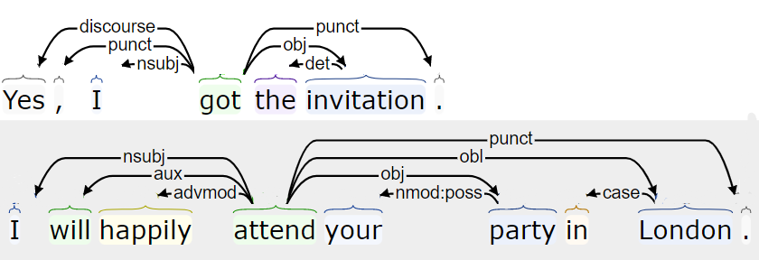
Natural language processing pipeline (cont.)
Dependency Parsing (DP) (cont.):
Apply dependency parsing (DP) to the example “Yes, I got the invitation. I will happily attend your party in London”
Dependency tag | Description
nsubj | nominal topic
punct | punctuation
discourse | discourse element
det | determiner
obj | the object of a verb
advmod | adverbial modifier
aux | auxiliary
nmod:poss | possessive nominal modifier
case | case-marking
Notes:
The slide shows the results of submitting the example “Yes, I got the invitation. I will happily attend your party in London”.
The dependency tags that are used in the example are:
nominal subject (nsubj): nominal, which is the syntactic subject and the proto-agent of a clause.
punctuation (punct): It is used for any piece of punctuation.
discourse: It is used for interjections and other discourse particles and elements, which are not clearly linked to the structure of the sentence, except in an expressive way.
obj: The object of a verb is the second most core argument of a verb after the subject. Typically, it is the noun phrase that denotes the entity acted upon or which undergoes a change of state or motion (the proto-patient).
advmod: An adverbial modifier of a word is a (non-clausal) adverb or adverbial phrase that serves to modify a predicate or a modifier word.
aux: An auxiliary of a clause is a function word that is associated with a verbal predicate that expresses categories such as tense, mood, aspect, voice or evidentiality. It is often a verb (which might have non-auxiliary uses) but many languages have nonverbal TAME markers, which are also treated as instances of aux.
nmod:poss It is used for a nominal modifier, which occurs before its head in the specifier position that is used for ‘s possessives.
Case: The case relation is used for any case-marking element, which is treated as a separate syntactic word (including prepositions, postpositions, and clitic case markers). Case-marking elements are treated as dependents of the noun that they attach to or introduce.
References:
CoreNLP - Online tool to apply dependency parsing
https://corenlp.run/
Universal Dependency Relations
https://universaldependencies.org/u/dep/

Slide 23
Natural language processing pipeline (cont.)
Part of speech (POS) tagging:
Tags words in correspondence with a particular part of speech (for example, nouns, verb, adjectives, pronouns) depending on the definition of the word and its context.
POS helps the computer to understand language and grammar and derive meaning from the input sentence.
The most famous data set is the Penn Treebank project.
Apply POS tags to the example:
First sentence:
“yes/UH” “,/,” ”I/PRP” “got/VBD” “the/DT” “invitation/NN” “,/,”
Second sentence:
“I/PRP” “will/MD” “happily/RB” “attend/VB” “your/PRP$” “party/NN”
“in/IN” “London/NNP”
Tag | Description
UH | Interjection
DT | Determiner
VBD | Verb, past tense
NN | Noun, singular or mass
MD | Modal
RB | Adverb
VB | Verb, base form
PRP | Personal pronoun
Notes:
POS tagging is the process of tagging each token with its grammatical representation, such as noun, verb, or adjective.
POS helps the computer to understand language and grammar and derive meaning from the input sentence.
In the example, the data set is English grammar, so according to the part of speech that are defined, the objective is to label each token by its proper grammar value, that is, the corresponding part of speech.
POS helps the computer to understand language and grammar and derive meaning from the input sentence. Many human-annotated data sets are publicly available. One of the most popular data sets is the one used by the Penn Treebank project.
References:
Part-of-speech tagging
https://en.wikipedia.org/wiki/Part-of-speech_tagging
Stanford Log-linear Part-Of-Speech Tagger
https://nlp.stanford.edu/software/tagger.shtml
Alphabetical list of part-of-speech tags used in the Penn Treebank Project:
https://www.ling.upenn.edu/courses/Fall_2003/ling001/penn_treebank_pos.html

Slide 24
Natural language processing pipeline (cont.)
Named Entity Recognition (NER):
Classifies named entities that are mentioned in the text into categories such as “People,” “Locations,” “Organizations,” and so on.
Example:
Text: “Google CEO Sundar Pichai resides in New York.”
Named entity recognition:
“Google” –> Organization
“Sundar Pichai” –> Person
“New York” –> Location
Apply named entity recognition (NER) to the example:
Second sentence: “I” “will” “happily” “attend” “your” “party” “in” “London”
“London” –> Location
Notes:
Named Entity Recognition (NER) is the process of detecting the named entity such as person name, movie name, organization name, or location.
References:
Preprocessing steps in Natural Language Processing (NLP)
https://www.educative.io/answers/preprocessing-steps-in-natural-language-processing-nlp
How to build an NLP pipeline
https://www.wikitechy.com/tutorial/nlp/how-to-build-an-nlp-pipeline

Slide 25
Natural language processing pipeline (cont.)
Chunking :
Collects individual pieces of information and groups them into larger units.
Helps to extract the important words from lengthy descriptions.
Example to identify nouns in a sentence:
Text: “I had burgers and pastries for breakfast.”
Chunk noun phrases: “burgers”, “pastries”, “breakfast”
Useful to group data within specific categories
Group fruits with certain nutritional properties: “fruits rich in proteins” and “fruits rich in vitamins”
Group cars with similar features: “cars with automatic gear” and “cars with manual gear”
Notes:
Chunking refers to the process of taking individual pieces of information and grouping them into larger units. Chunking can be used to identify part of speech and short phrases present in a sentence.
By grouping each data point into a larger whole, you can, for example, identify and group the part of speech noun, verb, adjective, adverb, preposition, conjunction, pronoun, and interjection and also short phrases formed by including any of these part of speech.
When you have loads of descriptions or modifications around a particular word or phrase of your interest, you use chunking to grab the required phrase or word alone, ignoring the rest around it. Hence, chunking paves a way to group the required phrases and exclude all the modifiers around them, which are not necessary for analysis.
Chunking is used in NLP applications, for example, to group fruits of a specific category, such as fruits rich in proteins, fruits rich in vitamins. Another example, chunking can also be used to group cars with similar features. For example, cars with automatic gear in one group and cars with manual gear into another group.
References:
Preprocessing steps in Natural Language Processing (NLP)
https://www.educative.io/answers/preprocessing-steps-in-natural-language-processing-nlp
How to build an NLP pipeline
https://www.wikitechy.com/tutorial/nlp/how-to-build-an-nlp-pipeline
What is Chunking in Natural Language processing?
https://www.analyticsvidhya.com/blog/2021/10/what-is-chunking-in-natural-language-processing/

Slide 26
Information retrieval

Slide 27
Information retrieval
Information retrieval is the process of accessing and retrieving the most appropriate information from text based on a particular query in natural language that is submitted by the user, with the help of context-based indexing or metadata.
An information retrieval system searches a collection of natural language documents with the goal of retrieving exactly the set of documents that matches a user’s question.
Information retrieval is the foundation of many search engines. .
Notes:
Information retrieval (IR) is the process of accessing and retrieving the most appropriate information from text based on a particular query in natural language that is submitted by the user, with the help of context-based indexing or metadata.
Google Search is the most popular example of an information retrieval application.
An information retrieval system searches a collection of natural language documents with the goal of retrieving exactly the set of documents that matches a user’s question. They have their origin in library systems.
These systems assist users in finding the information that they require but it does not attempt to deduce or generate answers. They provide information about the existence and location of documents that might contain the required information. The documents that satisfy the user’s requirement are called relevant documents. A perfect information retrieval system retrieves only relevant documents.
Reference:
Step by Step Guide to Master NLP – Information Retrieval
https://www.analyticsvidhya.com/blog/2021/06/part-20-step-by-step-guide-to-master-nlp-information-retrieval/

Slide 28
Information retrieval system steps
Indexing the collection of documents.
Transforming the query in the same way as the document content is represented.
Comparing the description of each document with that of the query.
Listing the results in order of relevancy.
Notes:
A user who needs information formulates a request in the form of a query in natural language. After that, the IR system returns output by retrieving the relevant documents, about the required information. The IR system accomplishes the goal by performing the following steps:
Indexing the collection of documents.
Transforming the query in the same way as the document content is represented.
Comparing the description of each document with that of the query.
Listing the results in order of relevancy.
References:
Step by Step Guide to Master NLP – Information Retrieval
https://www.analyticsvidhya.com/blog/2021/06/part-20-step-by-step-guide-to-master-nlp-information-retrieval/

Slide 29
Information retrieval systems main processes
Information retrieval systems consist of mainly two processes:
Indexing
The process of selecting terms to represent a text.
Tasks:
Matching
The process of finding a measure of similarity between two text representations
Tokenization of string
Removing frequent words
Stemming
The relevance of a document is computed based on the following parameters:
Term frequency (TF)
Inverse Document Frequency (IDF)
TF-IDF score
Notes:
Information retrieval systems consist of mainly two processes:
Indexing
Matching
Indexing is the process of selecting terms to represent a text.
Indexing involves:
Tokenization of string
Removing frequent words
Stemming
Two common Indexing Techniques:
Boolean Model
Vector space model
Matching is the process of finding a measure of similarity between two text representations.
The relevance of a document is computed based on the following parameters:
Reference:
Step by Step Guide to Master NLP – Information Retrieval
https://www.analyticsvidhya.com/blog/2021/06/part-20-step-by-step-guide-to-master-nlp-information-retrieval/

Slide 30
Term Frequency and Inverse Document Frequency
Term Frequency (TF): the number of times a term appears in a document.
TF(i, j) = (count of ith term in jth document)/(total terms in jth document)
Inverse Document Frequency (IDF): a measure of the general importance of the term.
ID (i) = (total no. of documents)/(no. of documents containing ith term)
TF-IDF score: is a combination of two weighting methods for information retrieval to determine how important a term is.
TF-IDF Score (i, j) = TF * IDF
Notes:
The relevance of a document is computed based on the following parameters:
TF. It stands for Term Frequency, which is the number of times a given term appears in that document.
TF (i, j) = (count of ith term in jth document)/(total terms in jth document)
IDF. It stands for Inverse Document Frequency, which is a measure of the general importance of the term.
IDF (i) = (total no. of documents)/(no. of documents containing ith term)
TF-IDF Score (i, j) = TF * IDF
Reference:
Step by Step Guide to Master NLP – Information Retrieval
https://www.analyticsvidhya.com/blog/2021/06/part-20-step-by-step-guide-to-master-nlp-information-retrieval/

Slide 31
Information extraction

Slide 32
Information extraction
Refers to the automatic extraction of structured information from unstructured or semi-structured text.
Examples of applications where information extraction is used:
Entities and relation identification
Sentiment analysis
Notes:
Information extraction refers to the automatic extraction of structured information from unstructured or semi-structured text.
For example, information extraction is used in the following applications:
Entities and relation identification
Sentiment analysis

Slide 33
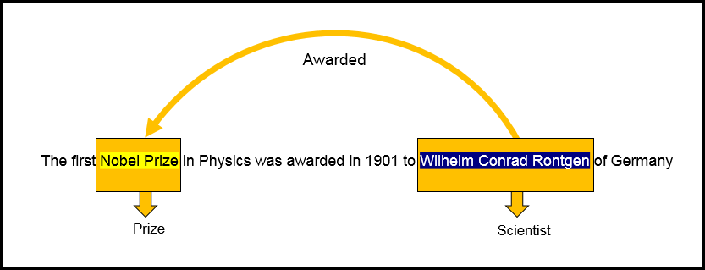
Information extraction (cont.)
Entities and relation identification
Notes:
As shown in this slide, “Nobel Prize” and “Wilhelm Conrad Rontgen” are identified as entities. The relationship is identified as awarded, which indicates the relationship between Wilhelm and the Nobel Prize.

Slide 34
Information extraction (cont.)
Sentiment analysis:
Detects user’s opinions in text.
Used in the field of chatbots, social media analysis, and others.
Examples:
“Their service is amazing” is a positive sentiment.
“The quality of food in this restaurant is terrible” is a negative sentiment.
“I am going to school” is a neutral sentiment.
Notes:
Sentiment analysis is the process of identifying emotions or opinions that are expressed in user input. It is used heavily in the fields of chatbots and social media analysis. It is also used in marketing because it captures a user’s opinion about a particular product or service so that an organization can take corrective action to keep the user satisfied.
Examples:
“Their service is amazing” is a positive sentiment.
“The quality of food in this restaurant is terrible” is a negative sentiment.
“I am going to school” is a neutral sentiment.

Slide 35
Unit summary
Define the NLP categories.
Describe the NLP pipeline.
Explain the challenges in natural language understanding (NLU).
Explain the concepts of information retrieval and extraction.
Describe sentiment analysis.

Slide 36

Review questions
The technique that is used to group together different inflected forms of a word into a base word is called:
Stemming
Dependency Parsing (DP)
Chunking
Lemmatization
What is the process of labeling tokens with their grammatical label?
Word tokenization
POS tagging
Semantic analysis
Stemming

Slide 37
Review questions (cont.)
True or False: For any NLP task, you must apply every step in the NLP pipeline.
True or False: Sentiment analysis is an NLU application.

Slide 38
Review answers
The technique that is used to group together different inflected forms of a word into a base word is called:
Stemming
Dependency Parsing (DP)
Chunking
Lemmatization
What is the process of labeling tokens with their grammatical label?
Word tokenization
POS tagging
Semantic analysis
Stemming

Slide 39

Review answers (cont.)
True or False: For any NLP task, you must apply every step in the NLP pipeline.
True or False: Sentiment analysis is an NLU application.

